Slide 1
UART Module

Slide 2
Agenda
UART Protocol
Operation
DMA
Example

Slide 3
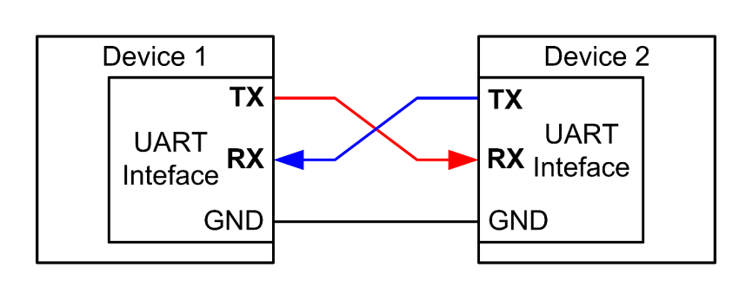
Universal Asynchronous Receiver and Transmitter (UART)
Universal
UART is programmable
Asynchronous
Sender provides no clock signal to receivers

Slide 4
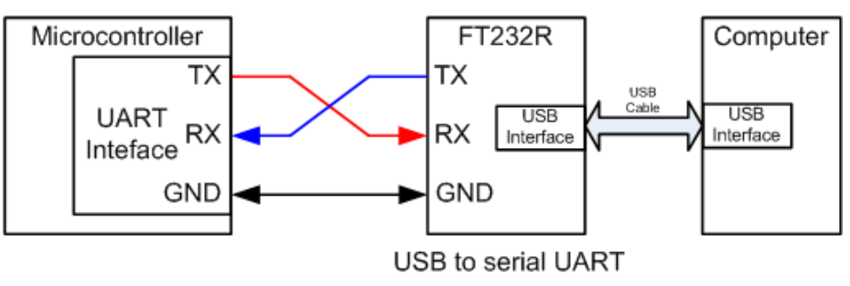
Connecting to PC
FT232R converts the UART port to a standard USB interface

Slide 5
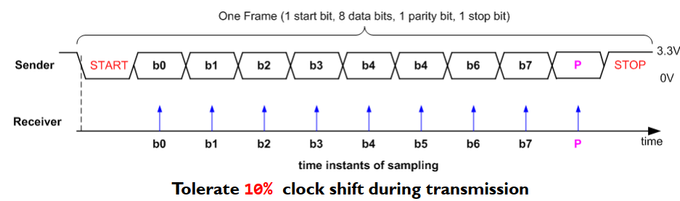
Data Frame
Sender and receiver uses the same transmission speed
Data frame
One start bit
Data (LSB first or MSB, and size of 7, 8, 9 bits)
Optional parity bit
One or two stop bit

Slide 6
Baud Rate
Historically used in telecommunication to represent the number of pulses physically transferred per second
In digital communication, baud rate is the number of bits physically transferred per second
Example:
Baud rate is 9600
Each frame: a start bit, 8 data bits, a stop bit, and no parity bit.
Transmission rate of actual data
9600/(1 + 8 + 1) = 960 bytes/second
The start and stop bits are the protocol overhead

Slide 7
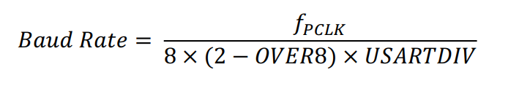

Baud Rate
If OVER8 is 0, then the signal is oversampled by 16, and 4 bits are used for the fractional part.
If OVER8 is 1, then the signal is oversampled by 8, and 3 bits are used.
If BRR is 0x1BC and OVER8 is 0, then 0x1B is the integer part and 0xC is the fractional part.

Slide 8
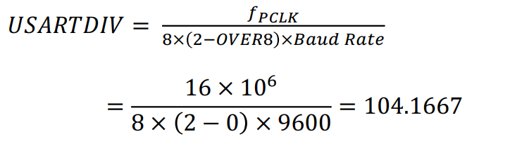

Baud Rate
Suppose the processor clock 𝑓𝑃𝐶𝐿𝐾 is 16MHz, and the system is oversampled by 16 (𝑂𝑉𝐸𝑅8 = 0),
Thus USARTDIV is 104.1875, which is encoded as 0x683, desired baud rate 9600

Slide 9
Error Detection
Even Parity: total number of “1” bits in data and parity is even
Odd Parity: total number of “1” bits in data and parity is odd
Example: Data = 10101011 (five “1” bits)
The parity bit should be 0 for odd parity and 1 for even parity
This can detect single-bit data corruption

Slide 10
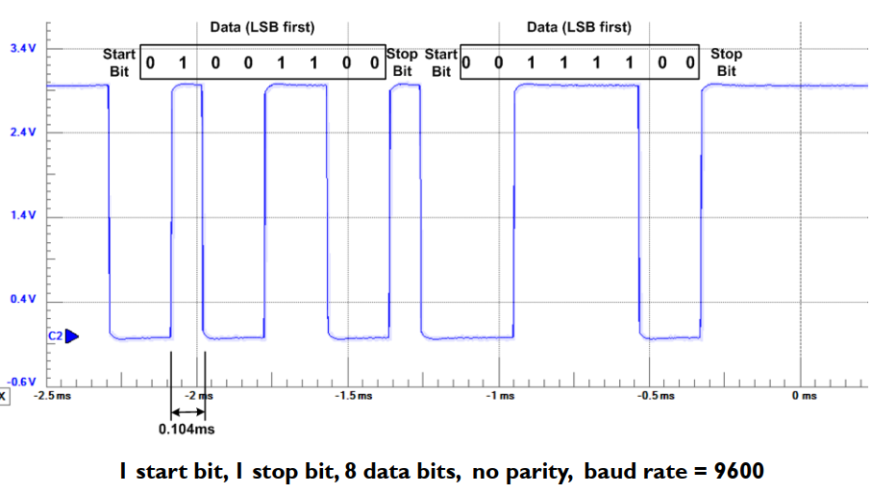
Transmitting 0x32 and 0x3C

Slide 11
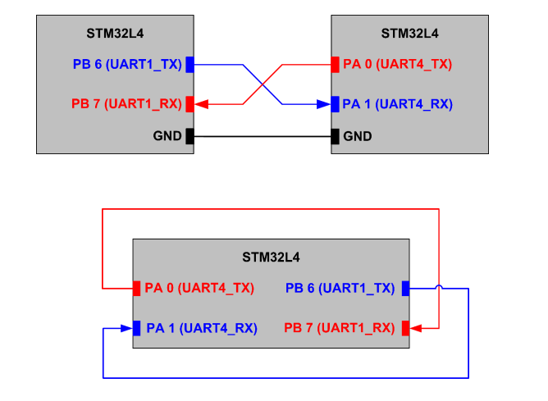
UART Connection

Slide 12
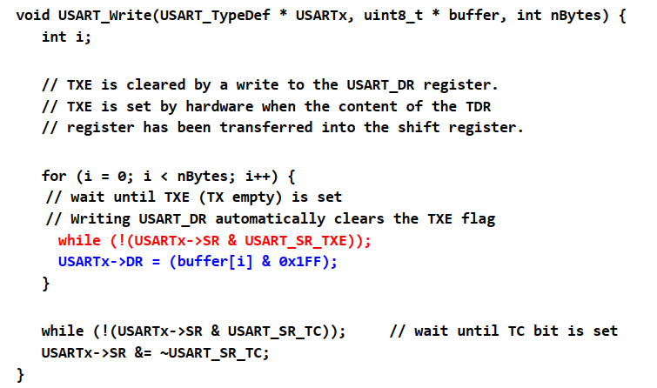
Sending Data

Slide 13
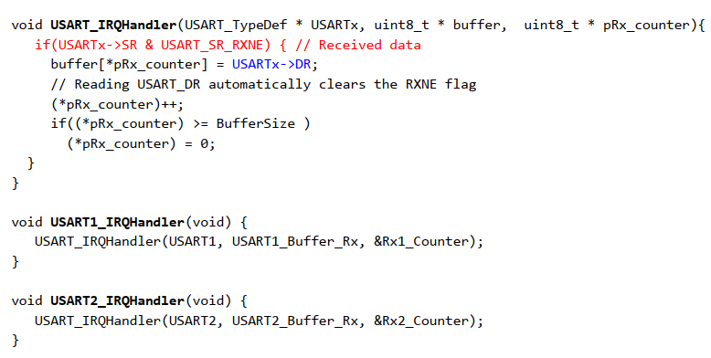
Receiving Data

Slide 14
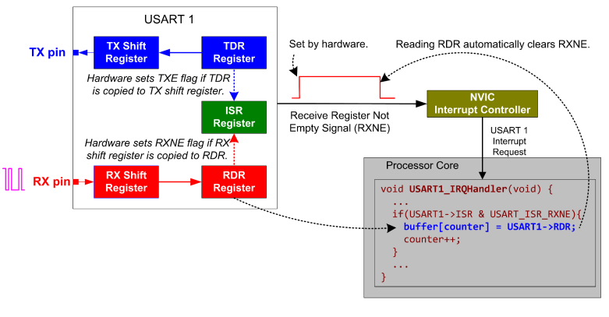
UART Interrupt: Receiving Data

Slide 15
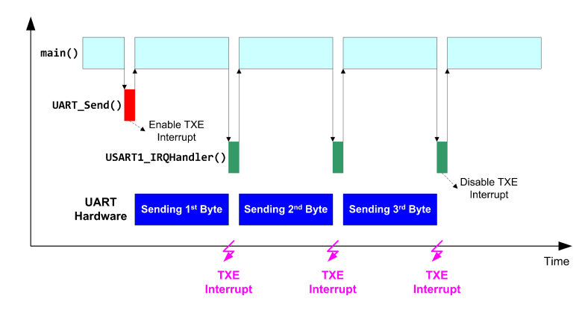
UART Interrupt: Receiving Data

Slide 16
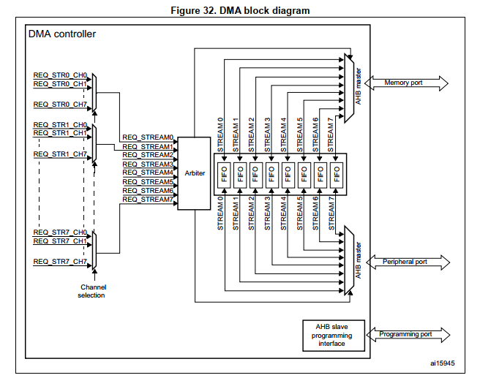
STM32 DMA: Block Diagram

Slide 17
STM32 DMA Features
Dual AHB master bus architecture, one dedicated to memory accesses and one dedicated to peripheral accesses
Independent source and destination transfer width (byte, half-word, word): when the source and destination data widths are different
Independent Incrementing or Non-Incrementing addressing for source and destination. Possibility to set increment offset for peripheral address.

Slide 18
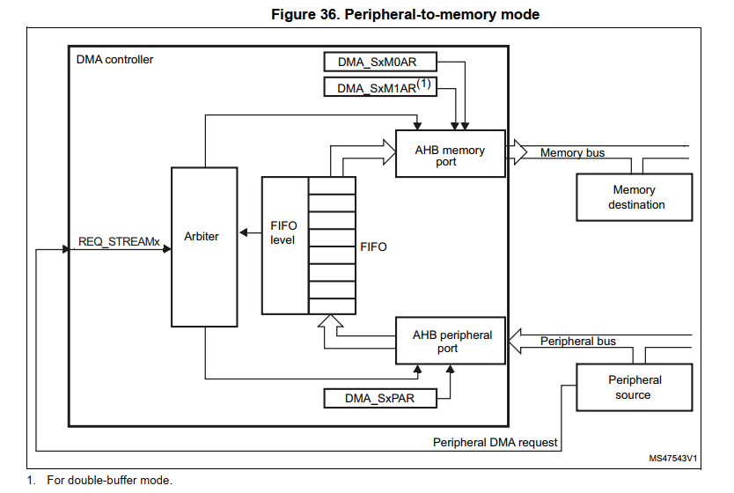
DMA – Peripheral to Memory Mode

Slide 19
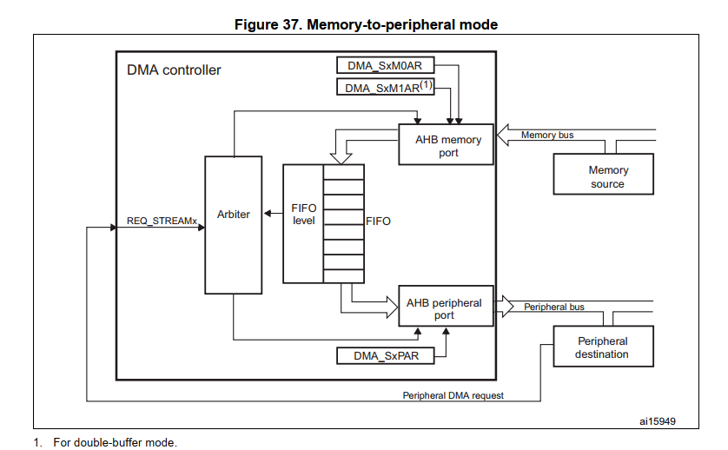
DMA – Memory-to-Peripheral mode

Slide 20
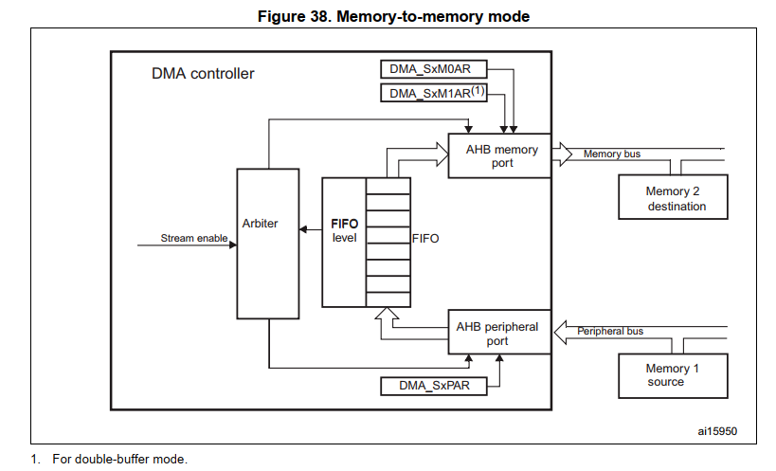
DMA – Memory-to-Memory mode

Slide 21
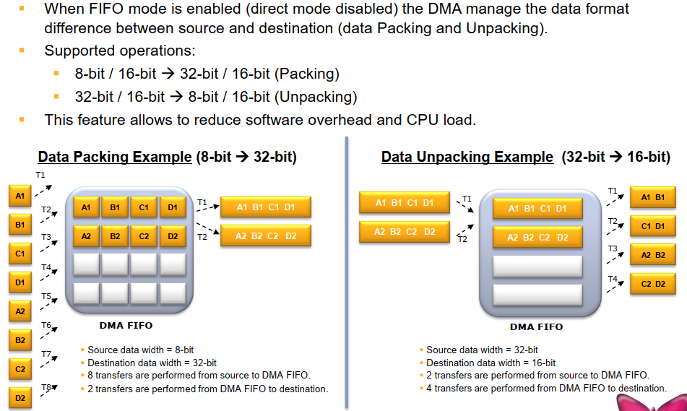
FIFO: Data Packing/Unpacking

Slide 22
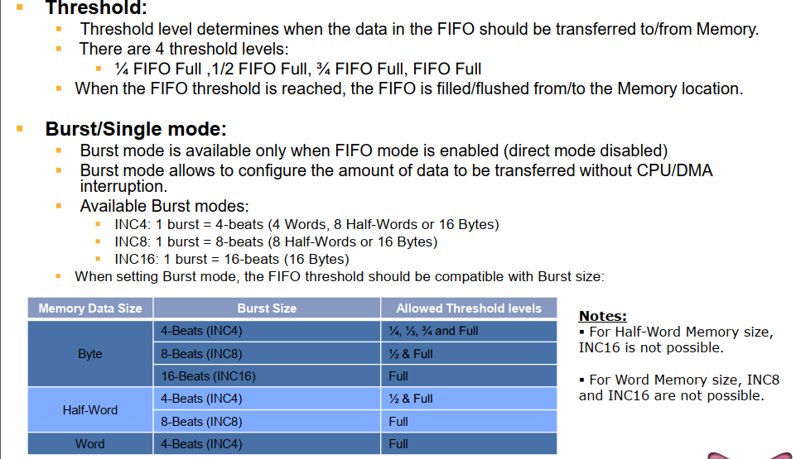
FIFO: Threshold & Burst mode

Slide 23
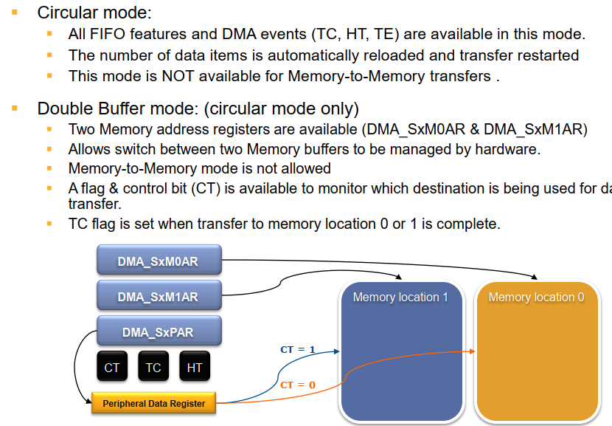
Circular & Double Buffer modes

Slide 24
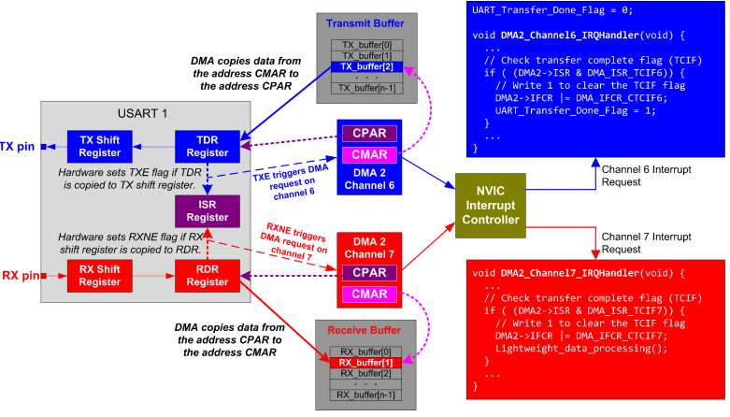
UART DMA: Receiving & Sending

Slide 25
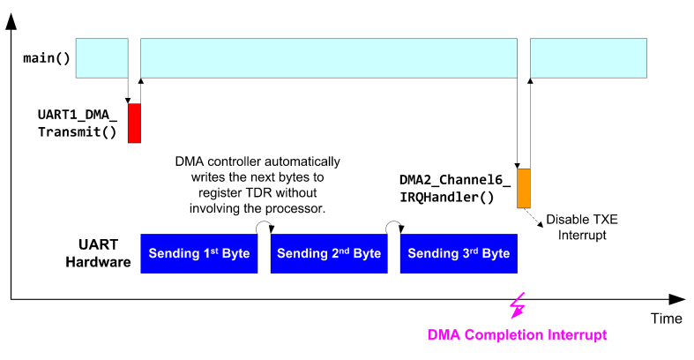
UART DMA: Receiving & Sending

Slide 26
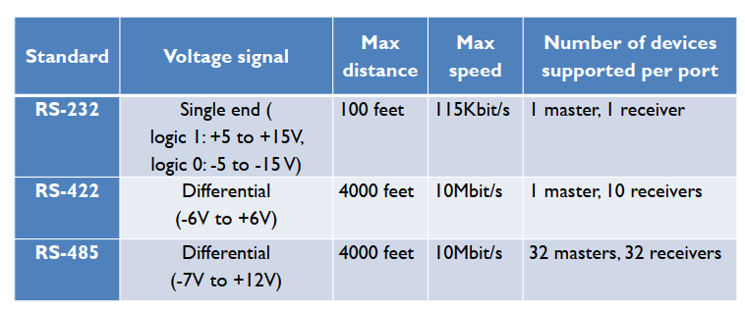
Voltage Levels

Slide 27
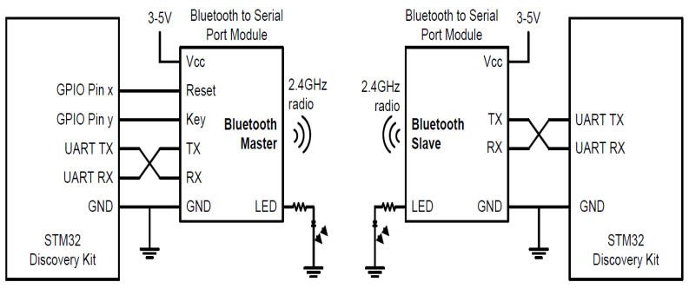
Bluetooth

Slide 28
Q&A

